Slide 1
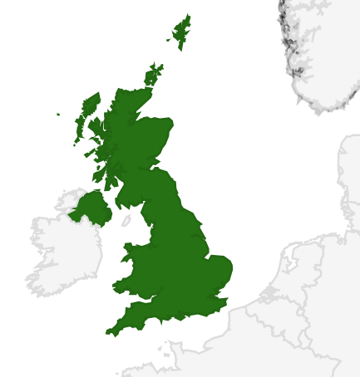

The Nature and The Scope of Environmental Health Services In The United Kingdom and What the United Kingdom has learned from the Rest of The World
Peter Wright

Slide 2
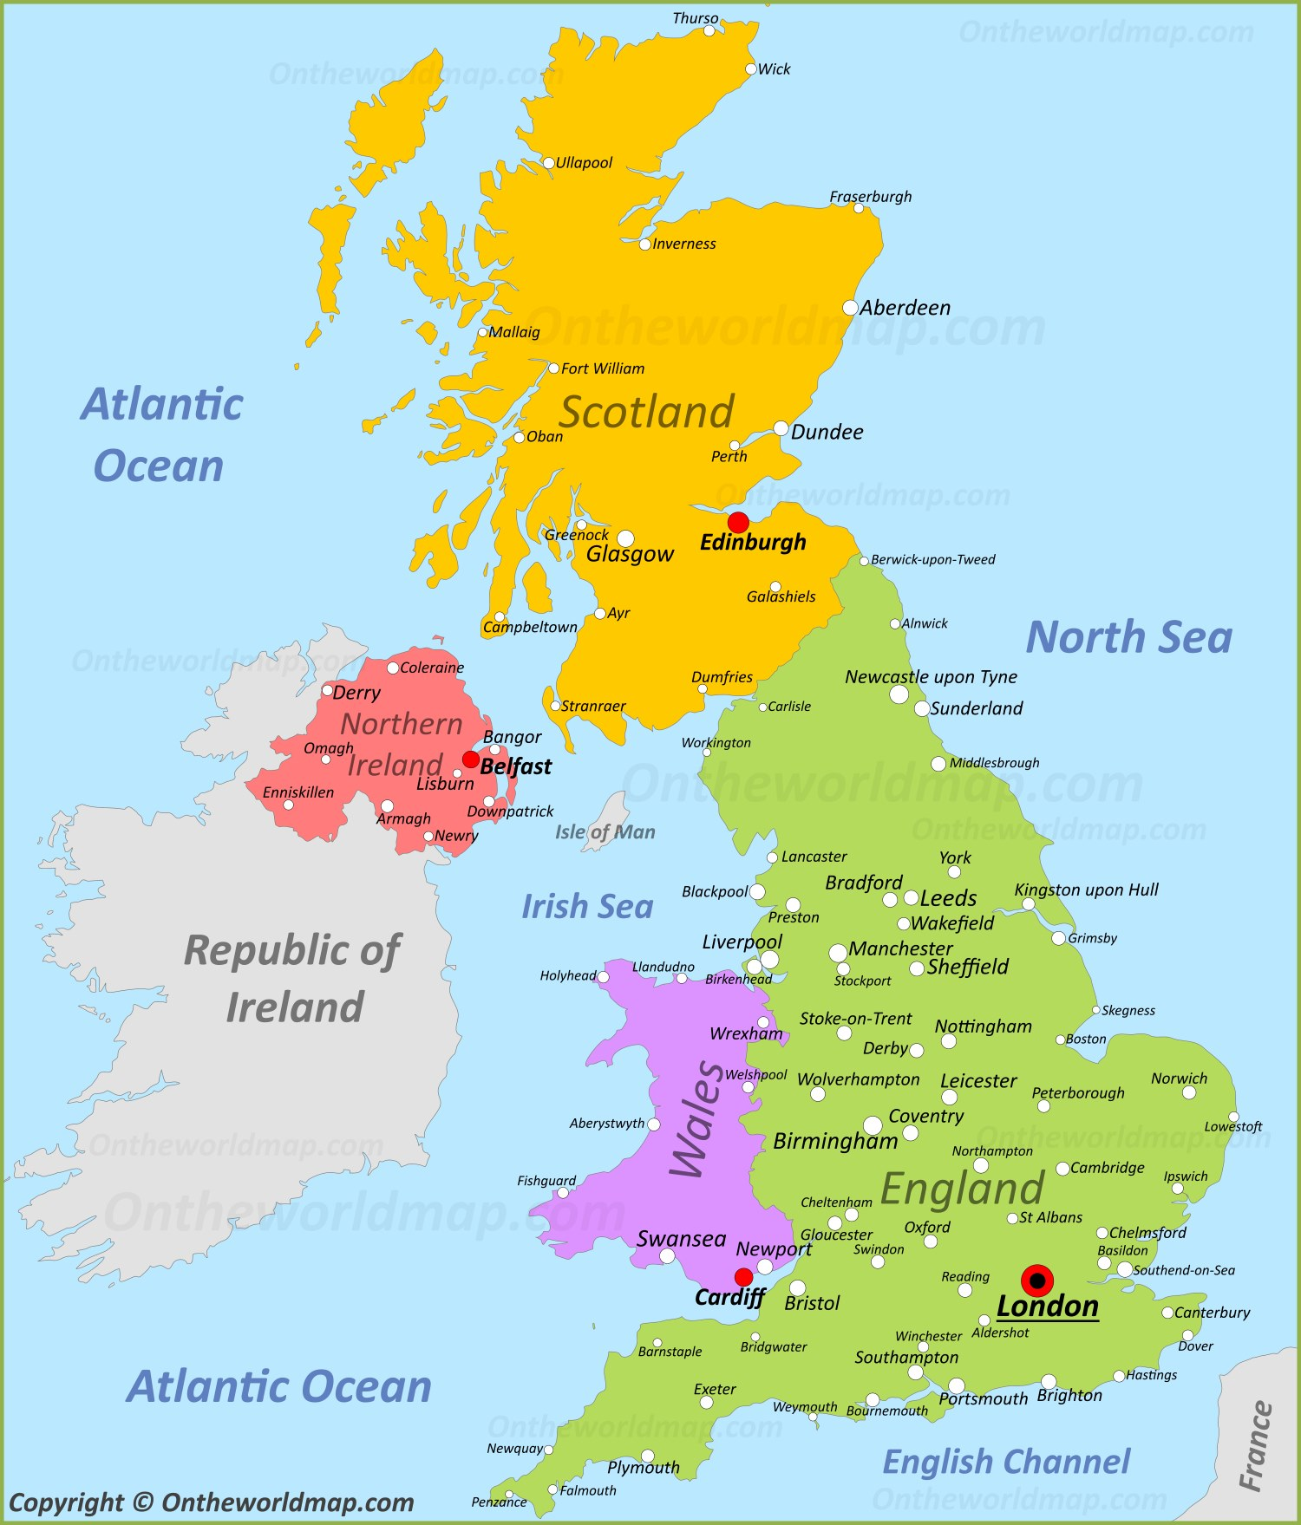
Please raise your hand if I’m talking too fast or you can’t understand me
Although I’m English, I have a strong regional accent.
It’s called “Geordie” if you’re interested
I also tend to talk too fast
I promise that I won’t be offended if you signal to me to talk more slowly or clearly.
me

Slide 3
The United Kingdom
We have a UK Government covering Scotland, Northern Ireland, Wales and England
Wales, Scotland and Northern Ireland have devolved Governments, with some devolved powers
England is governed solely by the UK Government in London
me

Slide 4
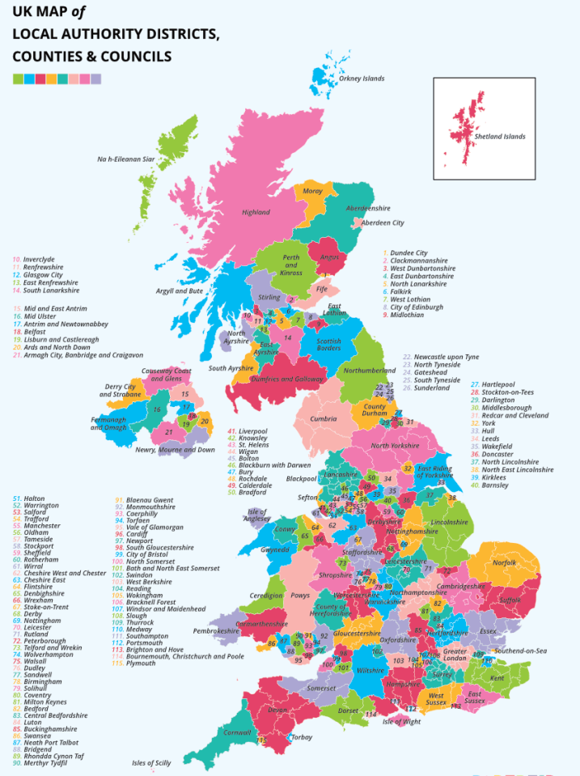
The United Kingdom
Our National Health service is the responsibility of each of the 4 nations
Public Health is split between the Governments and local authorities
Essentially ‘sickness’ and ‘illness’ is
Cured by the Governments, and
Prevented by local administrations

Slide 5
The United Kingdom
Our National Health service is the responsibility of each of the 4 nations
Public Health is split between the Governments and local authorities
Essentially ‘sickness’ and ‘illness’ is
Cured by the Governments, and
Prevented by local administrations
Local administrations are tasked with creating and maintaining Wellbeing

Slide 6


What is HEALTH? And why is the definition important?
Health isn’t just the absence of illness
The original World Health Organisation definition of health is:
“Health is a state of complete physical, mental and social well-being, and not merely the absence of disease or infirmity”

Slide 7
UK distribution of Illness Services, Health Services and Prevention/Protection and Wellbeing Services
National Governments:
Hospitals
Emergency Medical Aid
Doctors
Nurses
Health Visitors
Midwives
Psychiatry and Mental Health
Vaccinations
Local Administrations:
Environmental Health
Infectious disease control
Public Health
Social Workers
Refuse collection and disposal
Port Health
Building Safety Standards
Drinking water quality

Slide 8
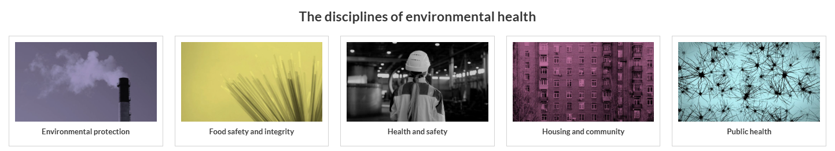


The Nature and The Scope of Environmental Health Services In The United Kingdom

Slide 9
Managing noise
Air quality
Contaminated land
Statutory nuisances

Slide 10

Regulation of food hygiene
Food business inspections
Food borne disease outbreak investigation
Chemical and composition quality

Slide 11
Regulating the safety of workers in businesses
Preventing accidents and work related disease
Maintaining high standards of safety for visitors to businesses

Slide 12
Ensuring minimum levels of safety, warmth and repair in homes
Preventing fuel poverty
Preventing homelessness
Stopping neighbours creating a noise nuisance

Slide 13
Controlling outbreaks of disease
Protecting drinking water sources from pollution
Disaster management

Slide 14
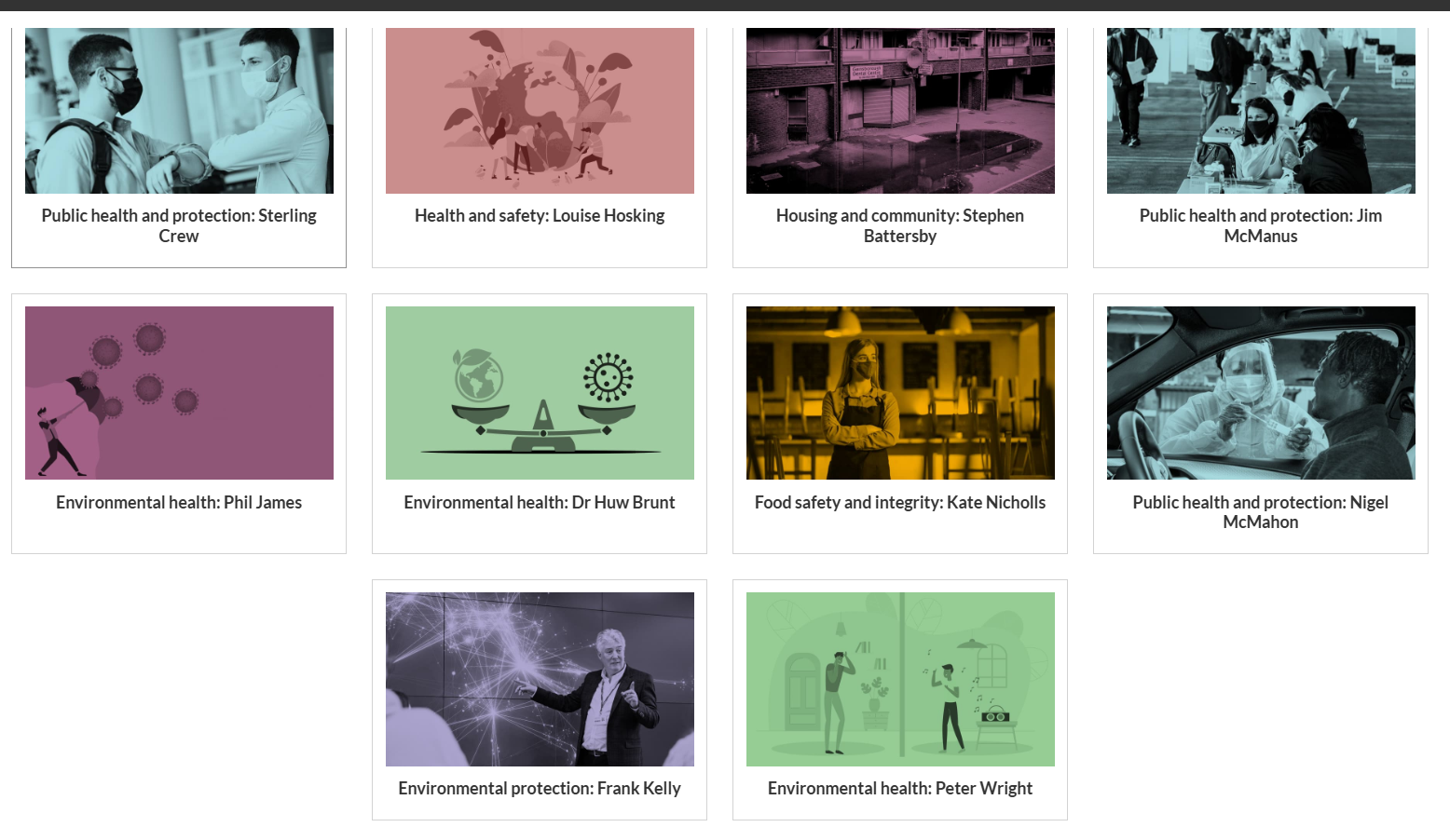
The way forward for environmental health in the UK?
https://www.cieh.org/what-is-environmental-health/the-future-of-eh/

Slide 15
What the United Kingdom has learned from the Rest of The World – Pandemic readiness
Pandemic Response and Covid 19
227,000 people in the UK died from Covid (70 million population)
We should have been able to keep the numbers much lower
What we learned
Ebola gave powerful lessons that we should have learned
Senegal’s response was outstanding
South Korea’s response was outstanding
UK believed it knew better – we need humility and respect

Slide 16
What the United Kingdom has learned from the Rest of The World - Immunisation
Immunisation
The worldwide programme to eradicate Smallpox was phenomenal
Probably the most spectacular project of any type ever!
What we learned
Diversity of knowledge and expertise is a force multiplier
Humility and learning are crucial
Achieving the impossible can be done

Slide 17
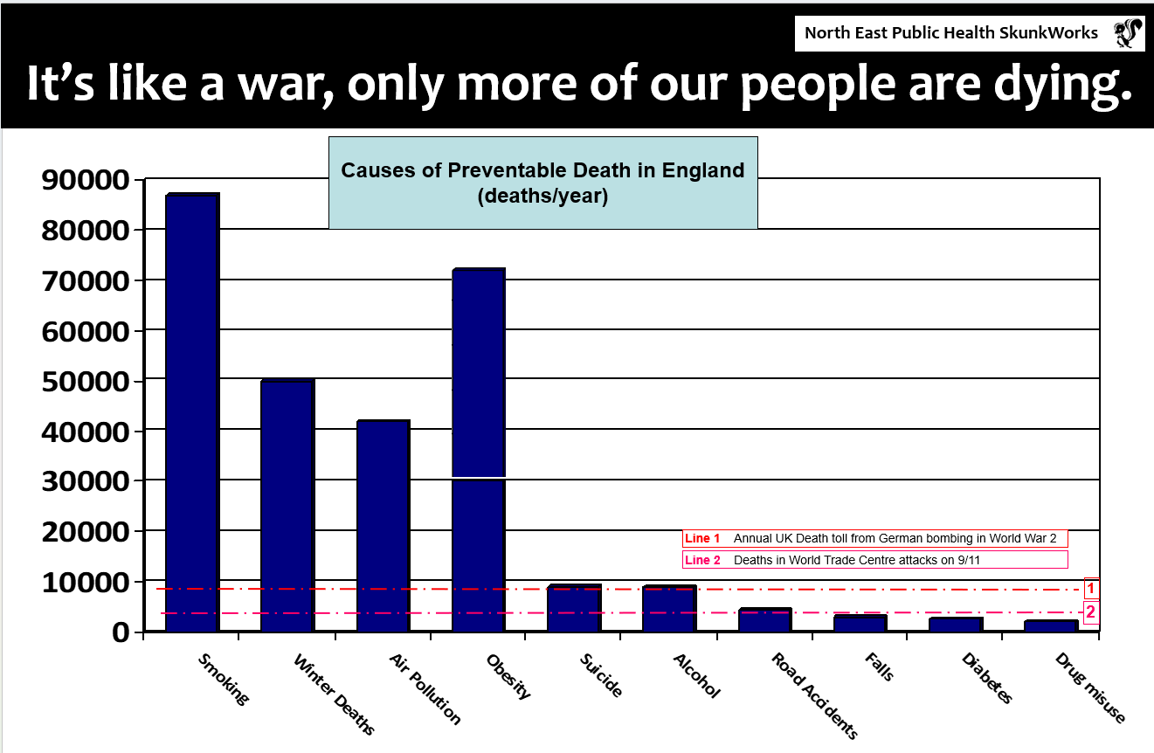
What the United Kingdom has learned from the Rest of The World – Lifestyle Diseases

Slide 18
Thank you for inviting me and for listening
Please do feel free to contact me afterwards with any questions you might have:
peter@peterwright.services
www.linkedin.com/in/peter-wright-bb510630

